Slide 1

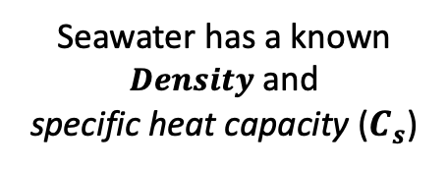

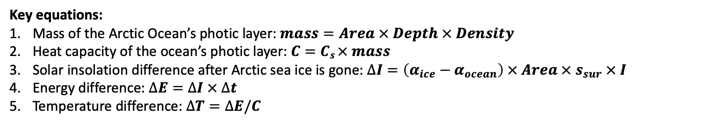
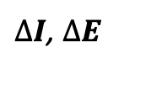
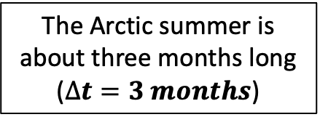


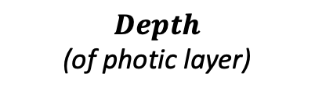

The Arctic summer is about three months long ($∆t=3 months$)
$$I$$
clouds
$$s_{sur}$$
$α$_{ocean}
$Area$ (of ice-covered Arctic Ocean)
$α$_{ice}
$∆I$, $∆E$
Seawater has a known $Density$ and
specific heat capacity ($C_{s}$)
$Depth$
(of photic layer)
Key equations:
Mass of the Arctic Ocean’s photic layer: $mass=Area × Depth × Density$
Heat capacity of the ocean’s photic layer: $C=Cs × mass$
Solar insolation difference after Arctic sea ice is gone: $∆I=\left(α_{ice}−α_{ocean}\right) × Area × s_{sur} × I$
Energy difference: $∆E=∆I × ∆t$
Temperature difference: $∆T=∆E/C$

